Slide 1
Product Case Study
Testing a change to the homepage categories on the viagogo website
Aksel Kohen

Slide 2
Table of Contents
The Experiment
Results
All Users
Users by Type
Users by Type and Channel
Users by Time of Week
Experiment Limitations
Recommendations
Further Research

Slide 3
The Experiment Overview
The current viagogo homepage displays the ten most popular categories by sales from customers
We’d like to test a change to the homepage to boost website performance and company revenue
The new homepage would display the ten categories closest to the user’s location rather than by popularity
We conduct an A/B test in which we show half the visitors the original homepage (the control) and the other half the new homepage (the variant)

Slide 4
The Experiment The Metrics
$$Conversion Rate=\frac{\# visitors to the homepage that subsequently make a purchase }{\# total visitors to the homepage}$$
$$Bounce Rate= \frac{\# visitors that bounce from the homepage}{\# total visitors that land on the homepage}$$

Slide 5
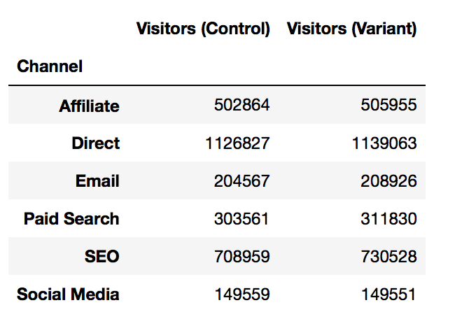
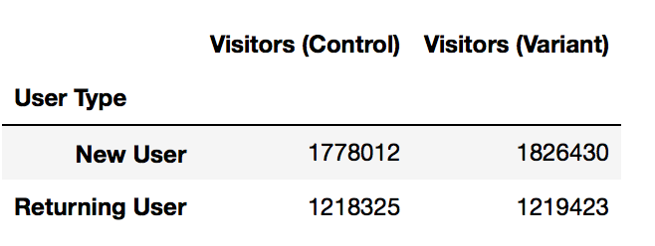
The Experiment Sample Data Validation
Ensure no sample bias
Make sure the variant and control contain an approximately equal number of visitors from all categories

Slide 6
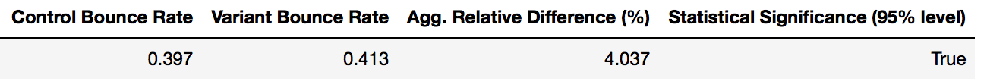
Results All Users: Overview
The Conversion Rate
The Bounce Rate

Slide 7
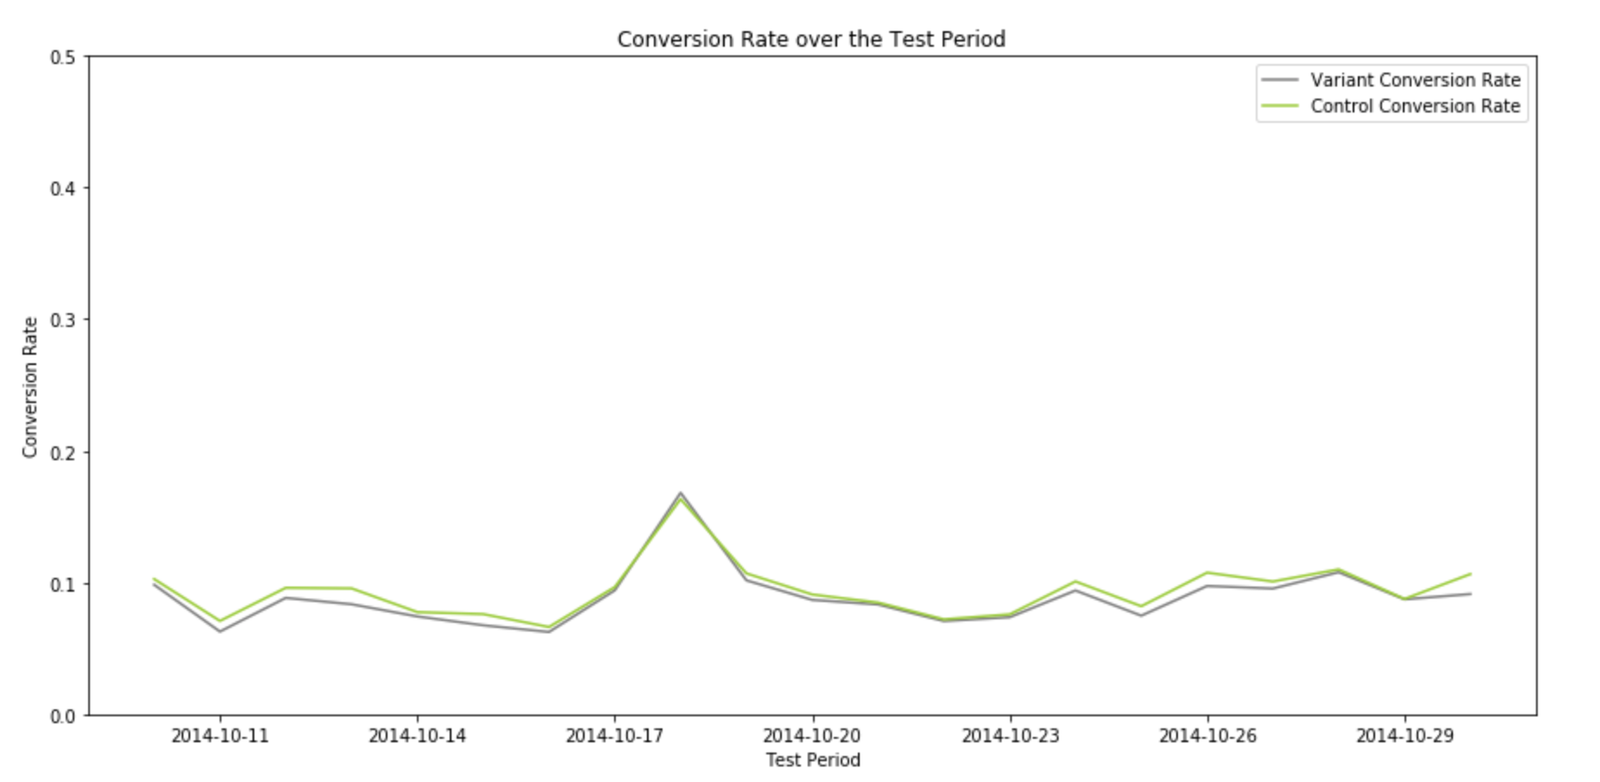
Results All Users: Daily Conversion Rate

Slide 8
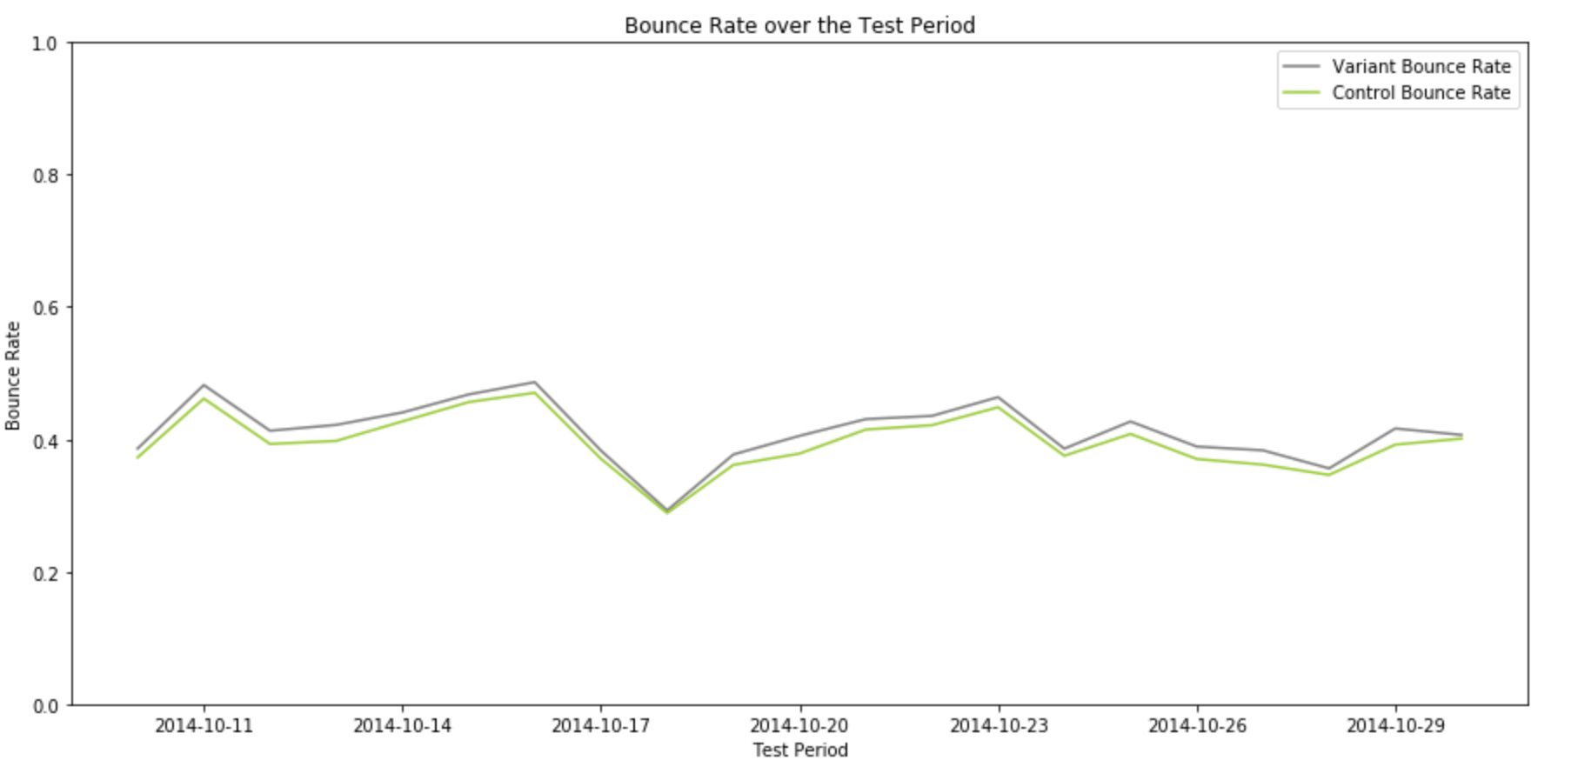
Results All Users: Daily Bounce Rate

Slide 9
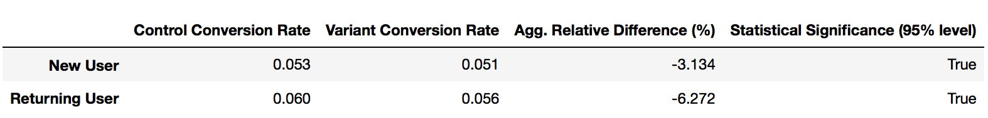
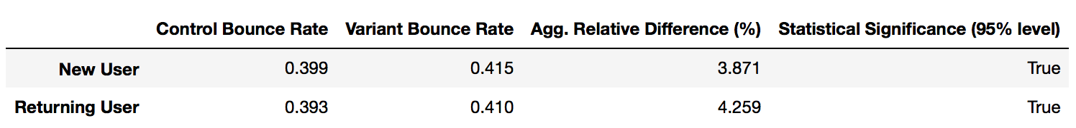
Results Users by Type: Overview
Conversion Rate by User Type
Bounce Rate by User Type

Slide 10
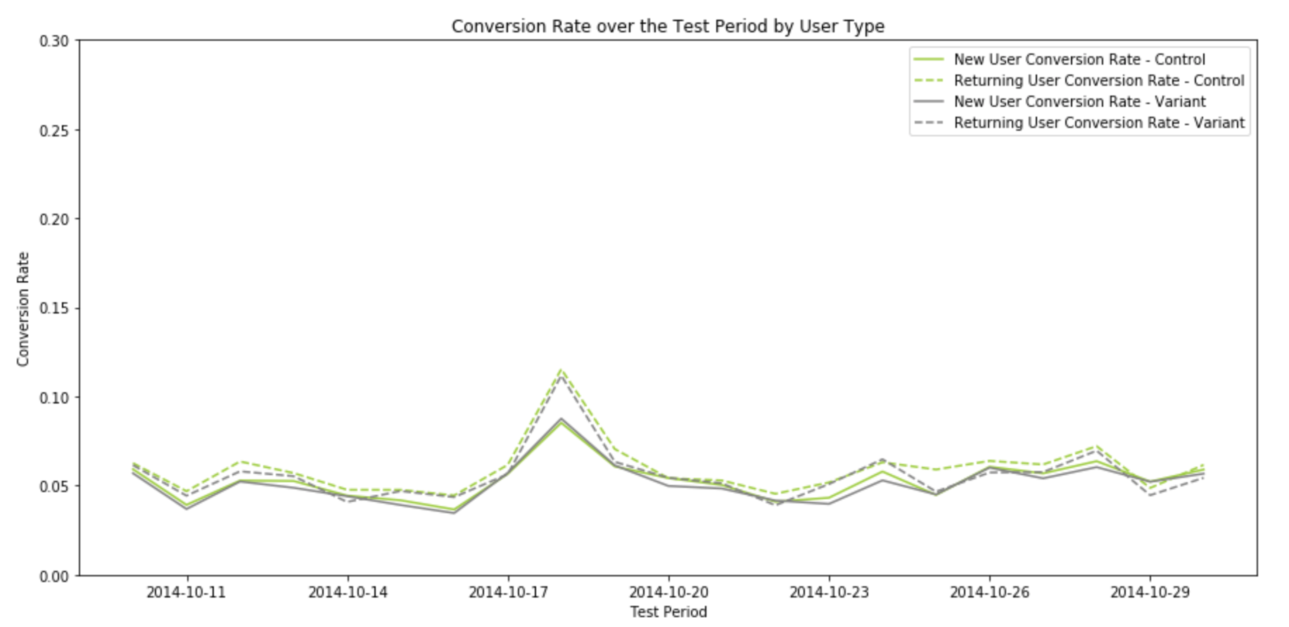
Results Users by Type: Daily Conversion Rate

Slide 11
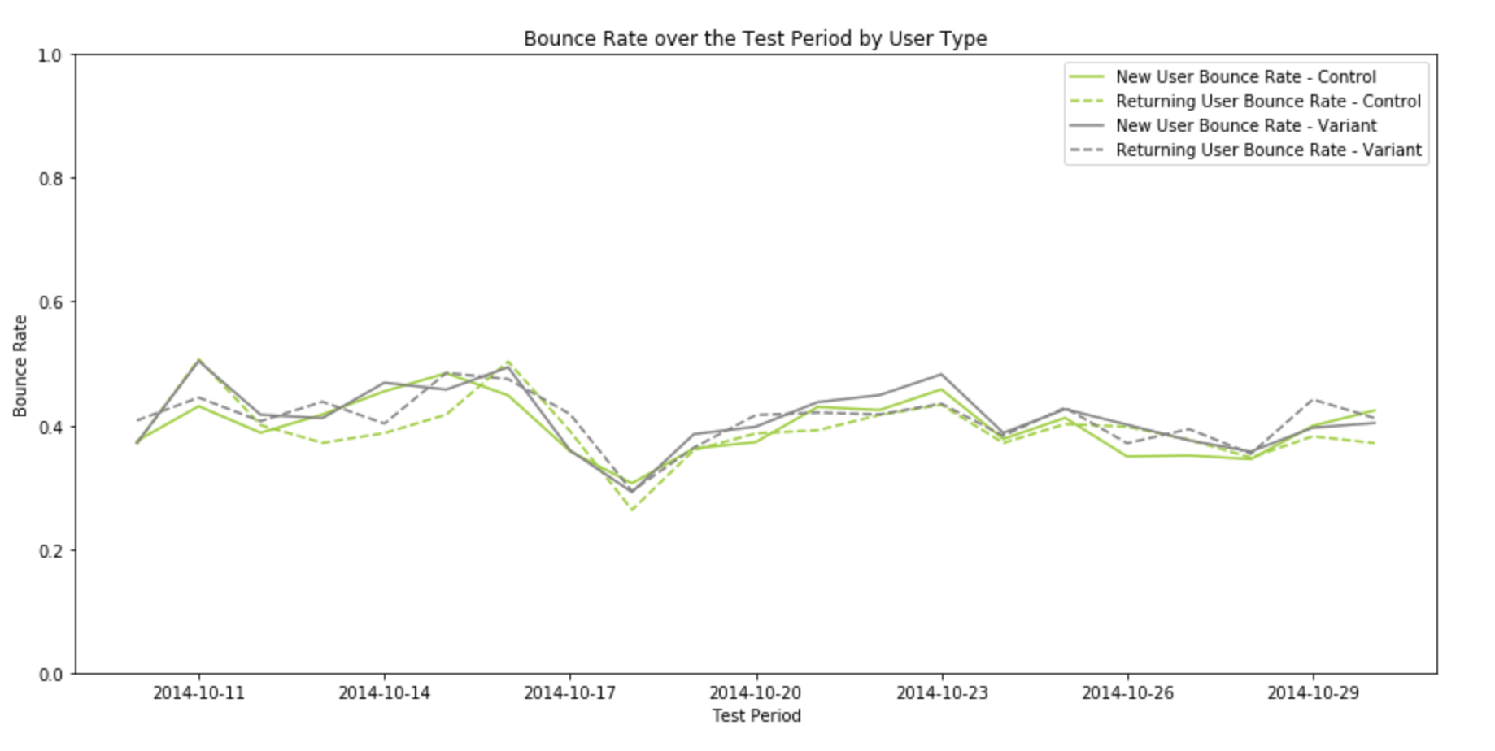
Results Users by Type: Daily Bounce Rate

Slide 12
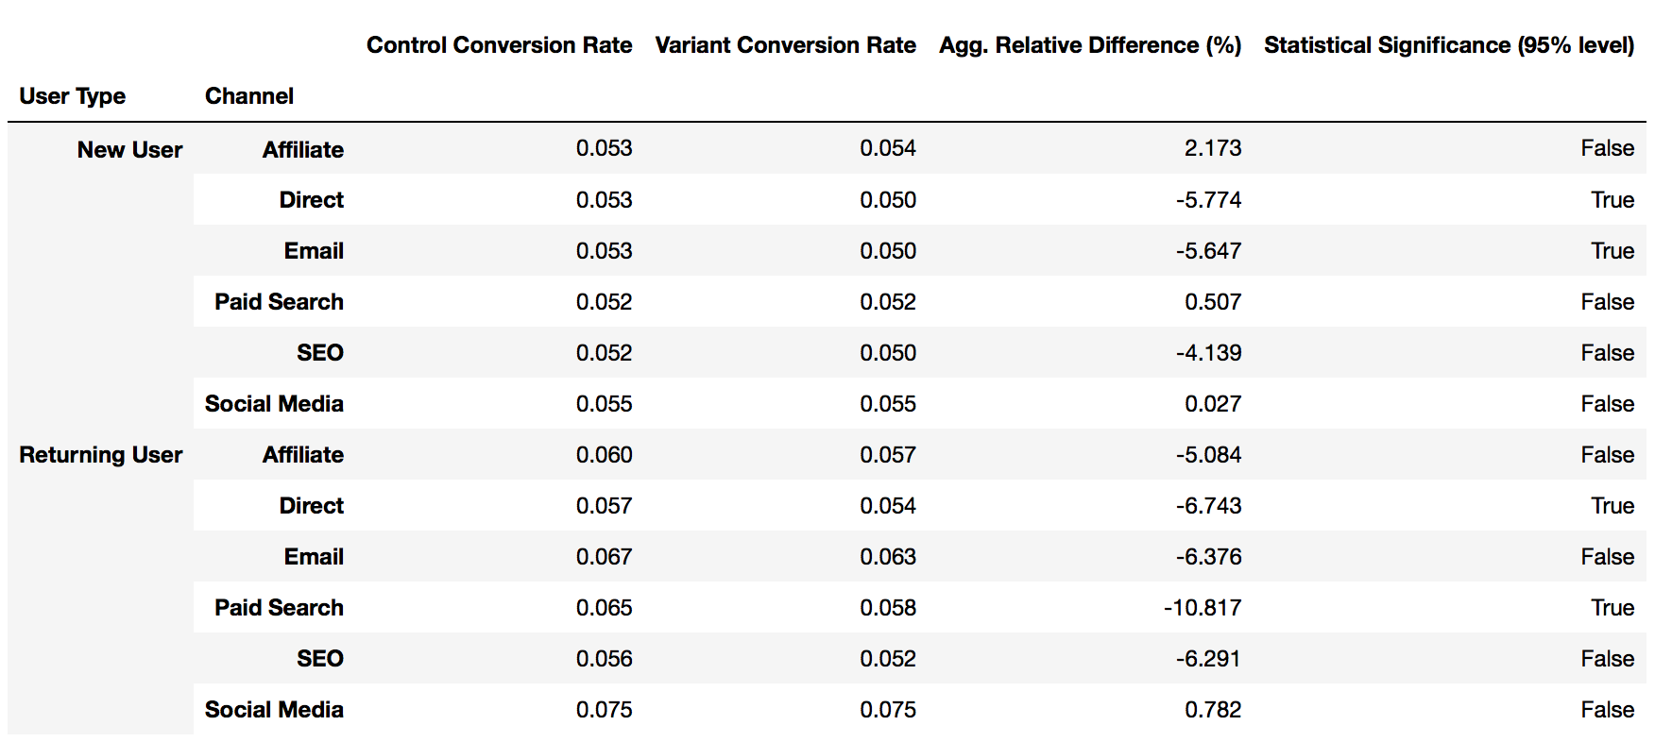
Results Users by Type and Channel

Slide 13
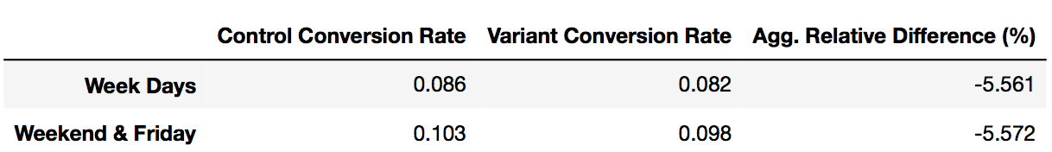
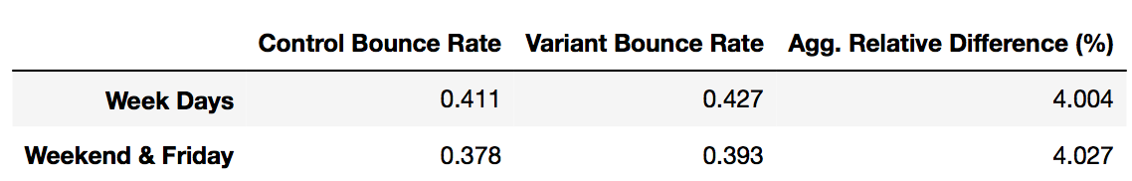
Results Users by Time of Week
Conversion Rate by Time of Week
Bounce Rate by Time of Week

Slide 14
Experiment Limitations Overview
The data was old – from 2014
The sample size was small and limited to the Fall season
The data did not contain a unique ID for each individual visitor
User location was missing

Slide 15
Recommendations Overview
Maintain the current homepage
The current homepage outperformed the new one on the aggregate level and in almost all subgroups
Conduct more experiments on niche cases where variant seemed useful
Some subgroups (Affiliate, New User)
Days with big events
Collect more data and repeat the experiment for some subgroups
Determine if statistical significance did not exist or was just difficult to establish

Slide 16
Further Research Potential Improvements
Show the most popular event categories in the user’s city rather those most popular overall
Create and sort homepage categories based on past browsing and purchase history on the viagogo website (similar to an Instagram explore page)
Add homepage alerts for popular events that are selling out fast
Replace category photos with videos
Repeat this experiment for rural and urban areas

